Slide 1
The Spotify dataset, by Kaggle
הרים כהרים ומים כמים
an ML pipline project
Guy Ray, BIUDS20

Slide 2


About the dataset
Research topic #1: who is Martin Garrix?
32,800 unique musical tracks (from 4sec short to 10min)
Thru the 50’s to 2020
2020: 785 new track, including by 379 new artists
10692 Artists . Travor Danial most popular, Martin Garrix with 161 tracks
22545 Albums (Martin Garrix with 73)
441 Playlists
Hi, I'm Martin Garrix
And the winner is….
About the business case
Notes:
Hosting over 100M tracks, royalites are 60% (~$7B/year) of Spotify’s costs
From onetime $10/track, to annual $20/track, to $5,000/1million streams.
Spotiy’s spend on Toni&I royalties is estimated as $10M-$20M
Predicting popularity of new tracks can directly improve bottom-line results of business.
Especially for less known artists

Slide 3
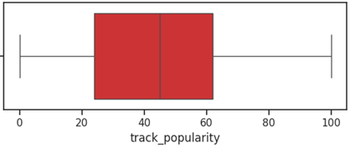
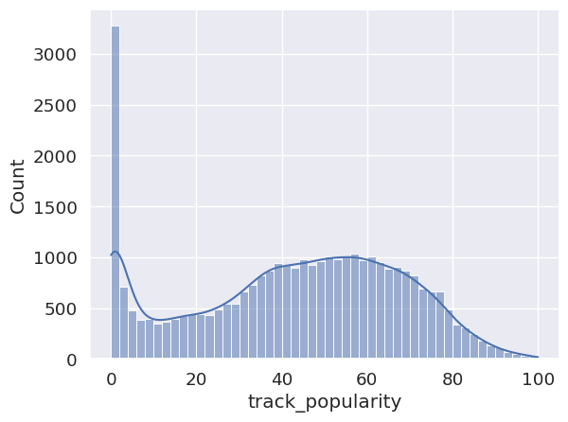
track_popularity (y_col)
Spotify Web API docs: Popularity of tracks is, in the most part, the total number of plays and how recent those plays are.
Community: The precise weights are not published. It’s uncertain whether things like e.g. “like,” “save to library”, playlist adds, or skip – influence popularity (Spotify doesn’t confirm).
2703 tracks
mean popularity
42.48
skew: -0.23
1 track

Slide 4
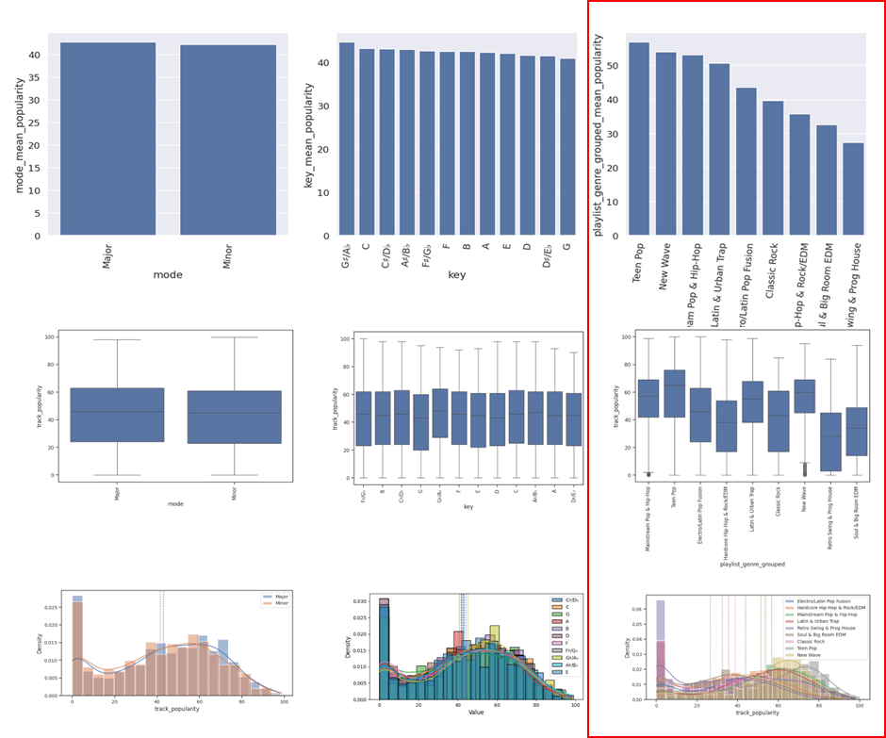
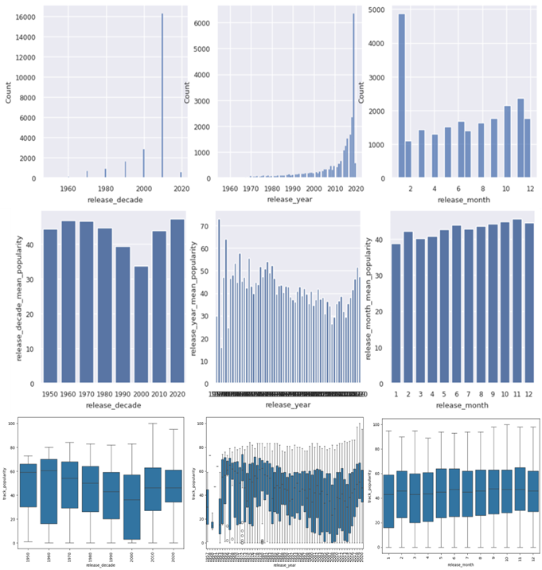
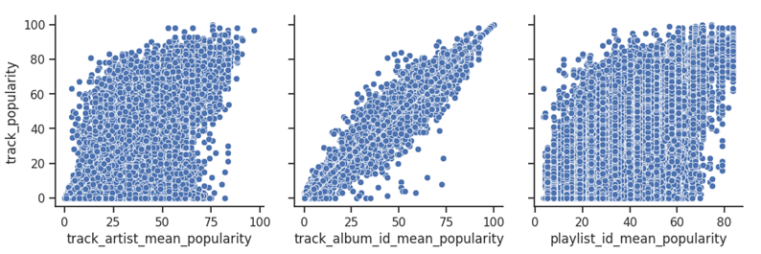
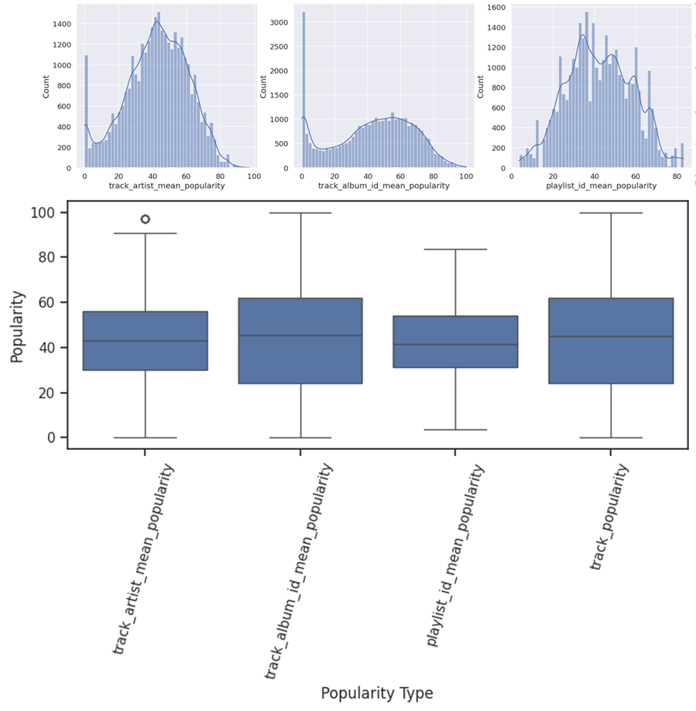
X_cat_col: cat value → cat_value_mean_pop
Artist “Bob Dylan” → 70.1
Album “Desire” → 76.9
Playlist “60s greatest hits” → 64.7
release_date →
release_decade_mean_pop
release_year_mean_pop
release_month_mean_pop
Key “C♯/D♭” → 42.3
Genre “TeenPop” → 56.6
Mode “Major” → 40.1
Notes:
Avoiding data leakage from “future” records, mean_popularity computed only from records up to “current” year (=2019). Applied to all records
The three large_cat_mean_popularity cols and y_col are of a normal distribution
No significant difference between the means of the three (F-stat: 1.95, p-value: 0.12)

Slide 5
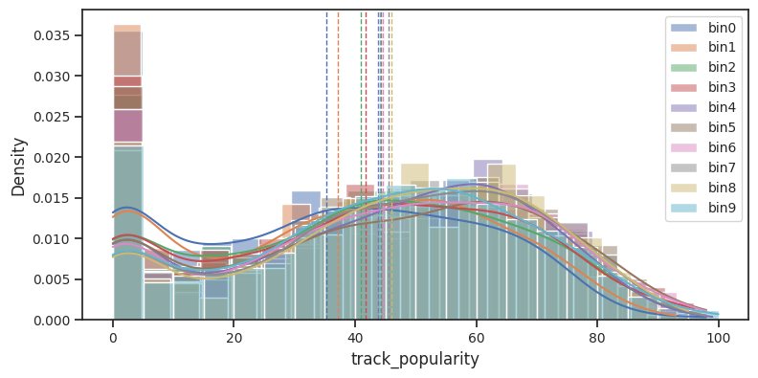
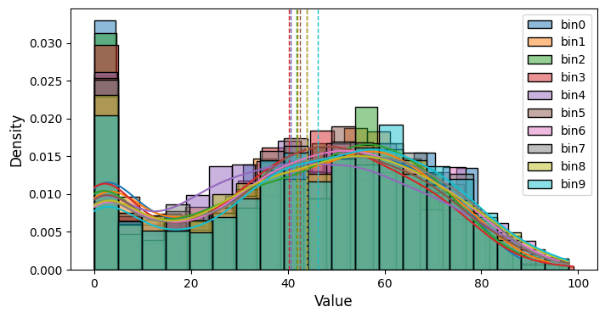
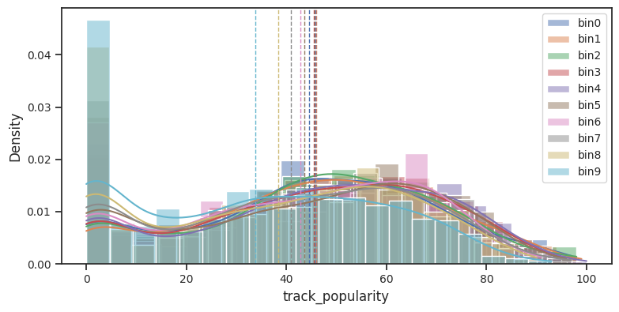
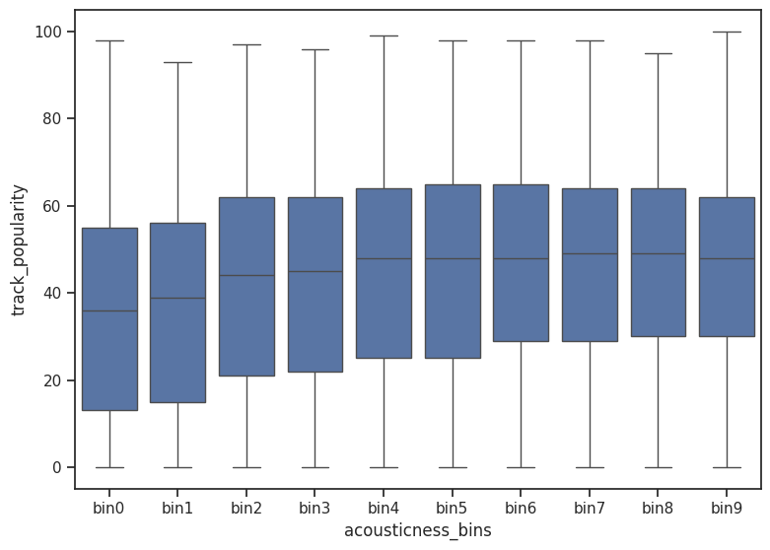
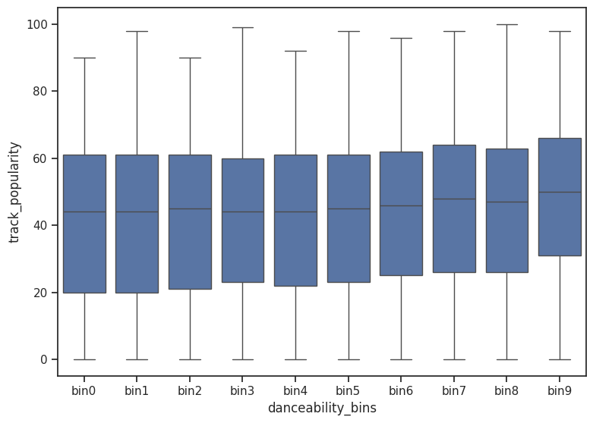
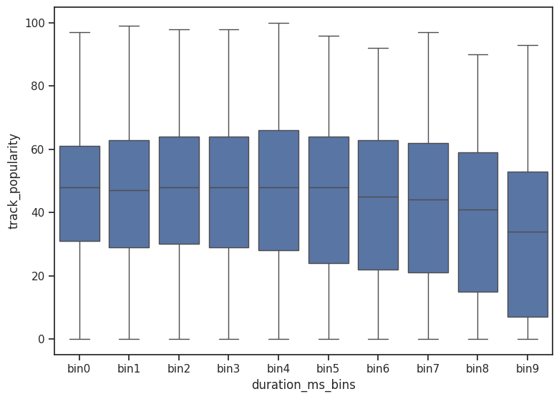
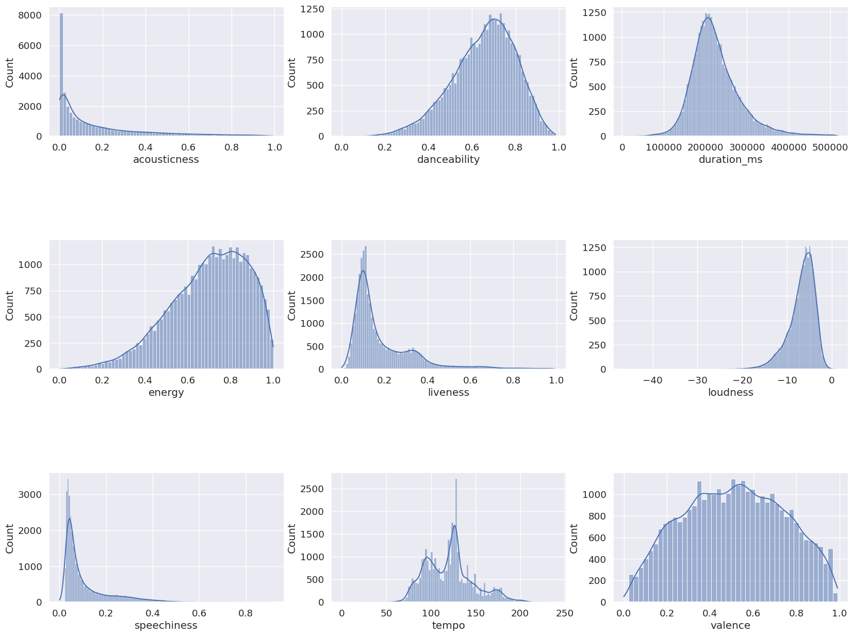
X_cont_cols
acousticness
skew: 1.6
skew: 1.14
skew: 2.1
skew: -1.37
skew: -0.01
Notes:
Nine continuance cols are modeling the “nature of the art”
Some at normal distribution same don’t
Using qcat-bins for ANOVA tests between mean popularity of bins
There is a significant different between the mean popularity of 10bins in all cont_cols, but speachiness
Kept as is

Slide 6
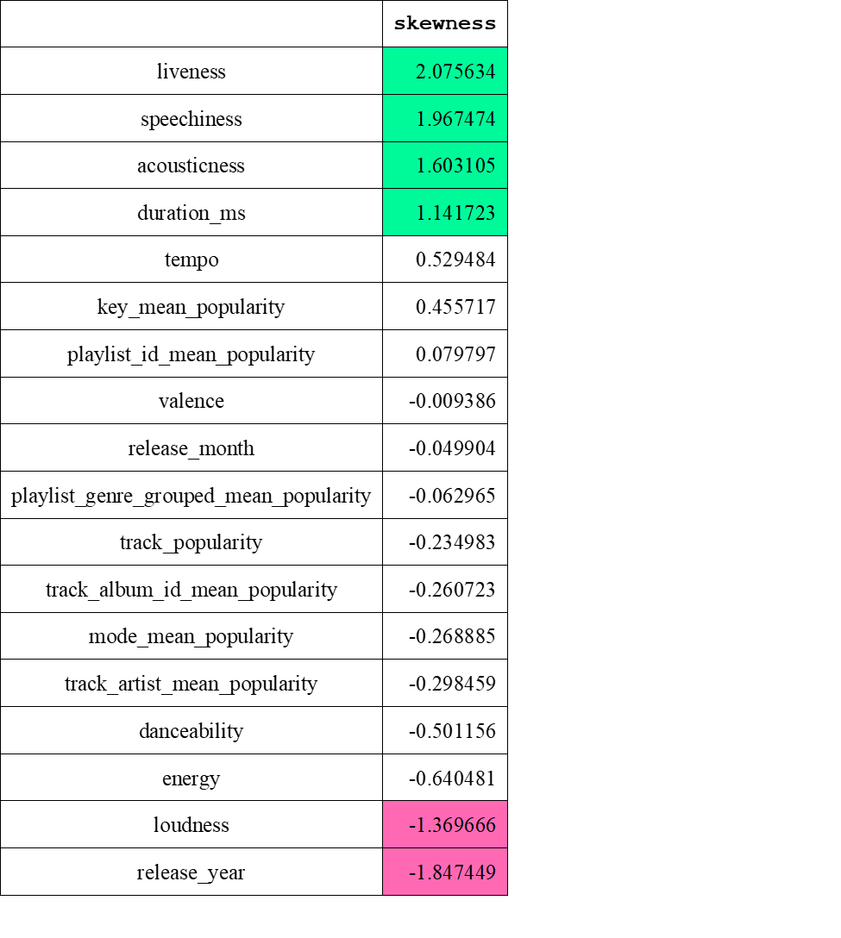
Outliers & Imputes
Using ANOVA to validate distributions of cols along the cleansing process: with outliers, without, after impute
With outlier, without, Impute | Significant diff
speechiness | True
liveness | True
acousticness | True
duration_ms | True
loudness | True
tempo | True
danceability | True
energy | True
valence | False
Without outliers, after Impute | Significant diff
Speechiness | False
Liveness | False
Acousticness | False
duration_ms | False
Loudness | False
Tempo | False
Danceability | False
Energy | False
Valence | False
Notes:
Using z-score to identify 3323 outlier cells (|z| > 3) in eight x_cols
Replaced with NaN
imputed values back with MICE (KNN runs the server out of RAM)

Slide 7
Experimenting MAD, IQR, ISO, LOF, DBSCAN, and z-score Choosing LOF
With outlier, without, Impute | p_value | Significant diff
tempo | 0.0001 | true
danceability | 0.2882 | false
speechiness | 0.2885 | false
duration_ms | 0.2933 | false
energy | 0.9659 | false
Acousticness | 0.9833 | false
valence | 0.9833 | false
liveness | 0.9913 | false
loudness | 0.9991 | false

Slide 8
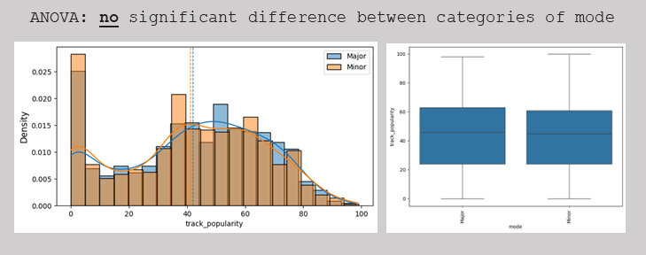
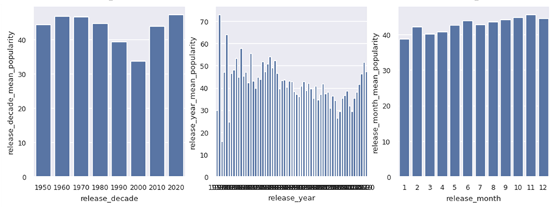
Feature selection
Spotify Web API docs: Popularity of tracks is, in the most part, the total number of plays and how recent those plays are.
Community: The precise weights are not published. It’s uncertain whether things like e.g. “like,” “save to library”, playlist adds, or skip – influence popularity (Spotify doesn’t confirm).
 | Lasso | GB | RF | Ridge | Sum
track_artist_mean_popularity
track_album_id_mean_popularity
playlist_id_mean_popularity
mode_mean_popularity
key_mean_popularity
playlist_genre_grouped_mean_popularity
release_decade_mean_popularity
release_month_mean_popularity
acousticness
danceability
duration_ms
energy
liveness
loudness
speechiness
tempo
valence
 | Lasso | GB | RF | Ridge | Sum
track_artist_mean_popularity | 0 | 1 | 1 | 1 | 3
track_album_id_mean_popularity | 1 | 1 | 1 | 1 | 4
playlist_id_mean_popularity | 1 | 1 | 1 | 1 | 4
mode_mean_popularity | 0 | 0 | 1 | 1 | 2
key_mean_popularity | 0 | 1 | 1 | 1 | 3
playlist_genre_grouped_mean_popularity | 0 | 1 | 1 | 1 | 3
release_decade_mean_popularity | 0 | 1 | 1 | 1 | 3
release_month_mean_popularity | 0 | 0 | 1 | 1 | 2
acousticness | 0 | 1 | 1 | 1 | 3
danceability | 0 | 1 | 1 | 1 | 3
duration_ms | 1 | 1 | 1 | 1 | 4
energy | 0 | 1 | 1 | 1 | 3
liveness | 0 | 1 | 1 | 1 | 3
loudness | 0 | 1 | 1 | 1 | 3
speechiness | 0 | 1 | 1 | 1 | 3
tempo | 0 | 1 | 1 | 1 | 3
valence | 0 | 1 | 1 | 1 | 3
duration_ms track_popularity corr: -0.23

Slide 9
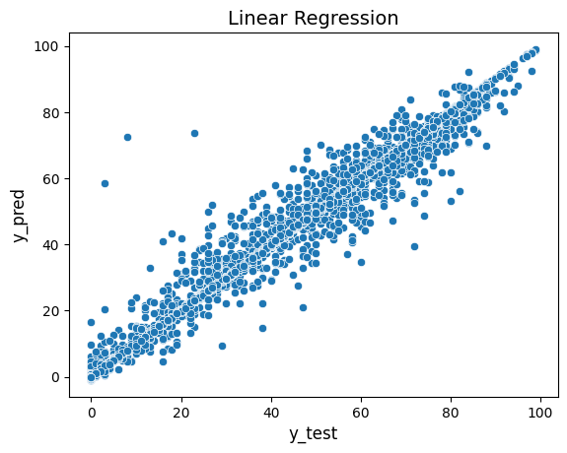
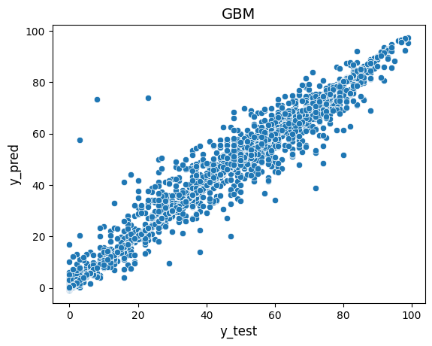
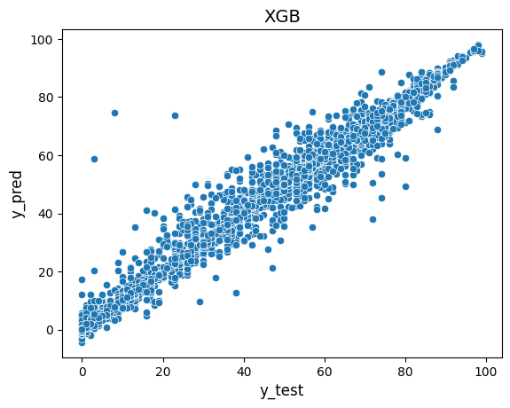
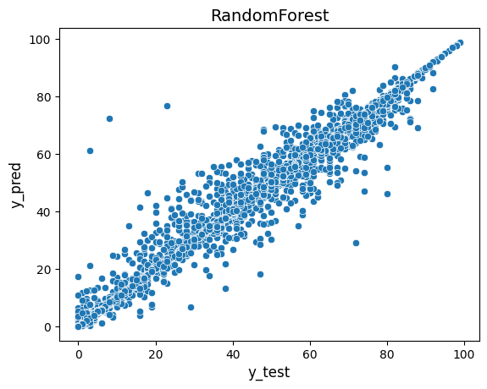
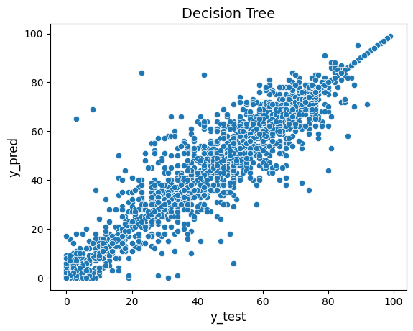
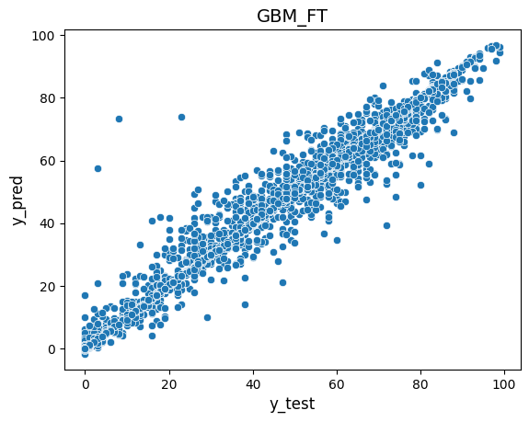
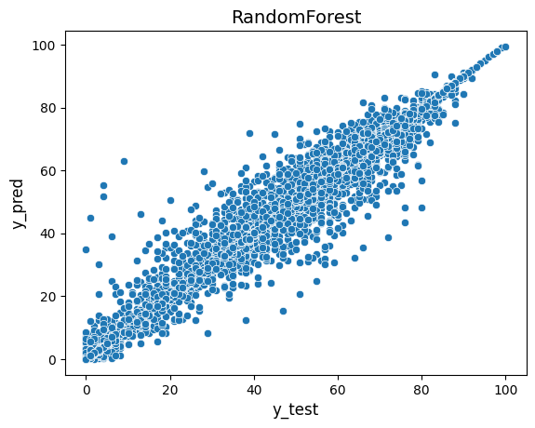
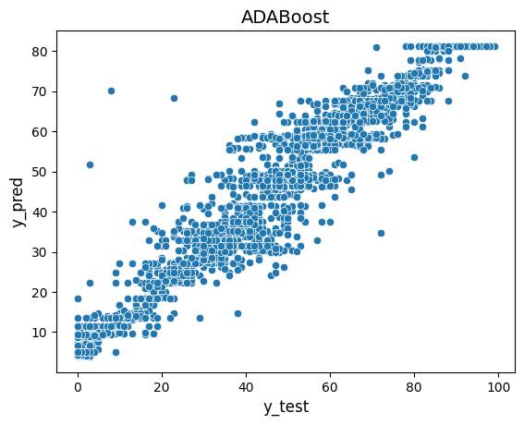
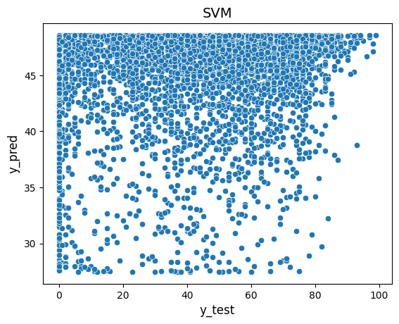
Model selection
finalist
 | MSE | RMSE | MAE | R2
Linear Regression | 14.354 | 3.789 | 1.578 | 0.978
GBM_FT | 14.516 | 3.81 | 1.619 | 0.977
GBM | 14.637 | 3.826 | 1.63 | 0.977
RandomForest | 15.675 | 3.959 | 1.667 | 0.976
XGB | 14.735 | 3.839 | 1.877 | 0.977
Decision Tree | 29.086 | 5.393 | 2.207 | 0.955
ADABoost | 34.858 | 5.904 | 4.403 | 0.946
SVM | 635.226 | 25.204 | 20.985 | 0.01
 | MSE | RMSE | MAE | R2
GBM | 8.014 | 2.831 | 1.052 | 0.987
GBM_FT | 8.014 | 2.831 | 1.083 | 0.987

Slide 10
ובא לציון גואל
הרים כהרים ומים כמים

Slide 11
The ML pipeline
FT | Model | FE / FS | Cleansing | EDA | Prep. (see also FE) | X_cols
GBM GBM_FT Pickle model Pickle df | Random Forest GBM XGB Linear ADABoost Decision Tree SVM Pickle models | replacing each col with col_mean_pop (“Dylan” → 71.2) Pickle | Outlier detection Experimenting with: Z_score, IQR, IOS, LOF, DBSCAN, MAD Choosing LOF Replace with NaN Imputing with MICE Pickle | histplot, boxplot, skewness pairplot vs. y_col correlations vs y_col Testing ANOVA between all popularity cols | Flatfile Target encoding. Replacing each col with col_mean_pop (e.g “Dylan” → 71.2) Pickle | large_cat_cols (3)
 |  | adding cat_mean_pop foreach col e.g. key_mean_pop mode_mean_popularity was not selected Pickle | Outlier detection Experimenting with: Z_score, IQR, IOS, LOF, DBSCAN, MAD Choosing LOF Replace with NaN Imputing with MICE Pickle | histplot, boxplot, skewness pairplot vs y_col Correlations vs y_col Testing ANOVA between pops of categories in each col E.g. popularity of C♯ vs D♭ | Flatfile Replacing cat codes with symbols for visualizations Target encoding. Adding cat_mean_pop foreach col. e.g. key_mean_pop Using ANOVA to condense categories into ~10 groups | small_cat_cols (3)
 |  |  |  | histplot box_plot Testing ANOVA between pops of 10 qcat-bins of each col | Flatfile Pickle | cont_cat_cols (9)
 |  | N/A | N/A | N/A | Flatfile replacing release_date with six cat cols Pickle | data_cols (2)
total x_cols = 15 | total x_cols = 15 | total x_cols = 27 | total x_cols = 27 | total x_cols = 27 | total x_cols = 27 | total x_cols = 17

Slide 12
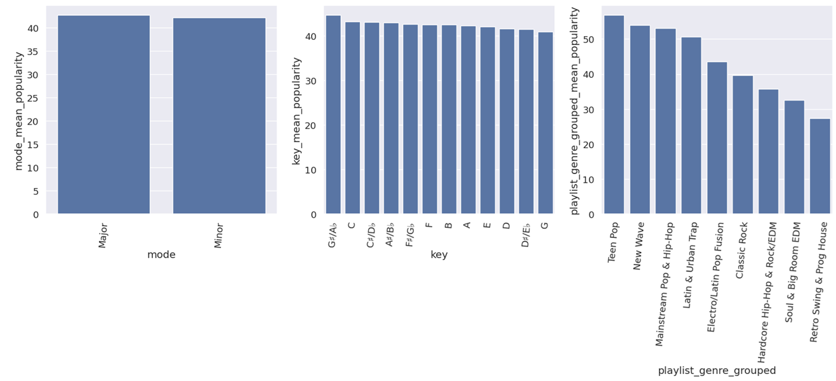
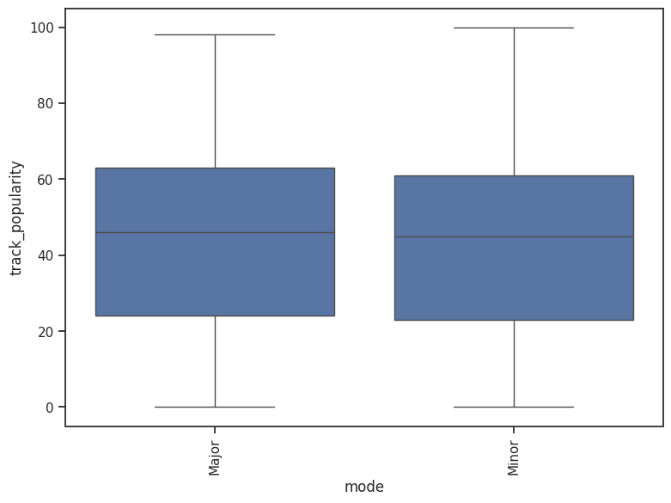
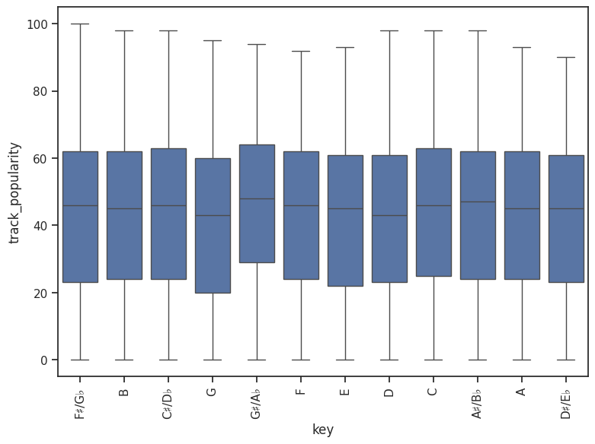
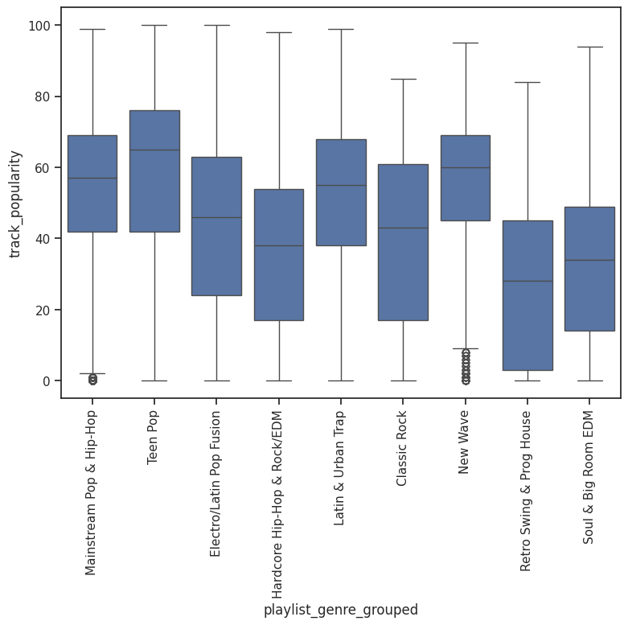
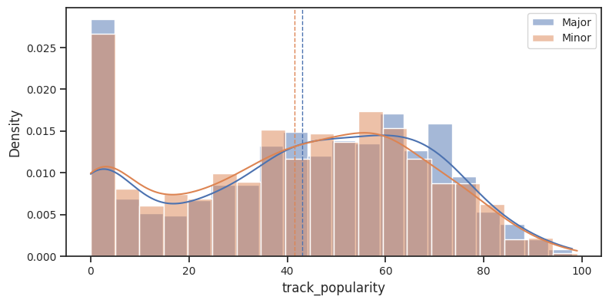
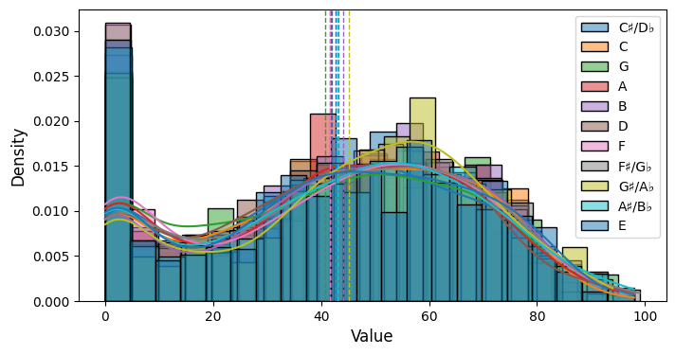
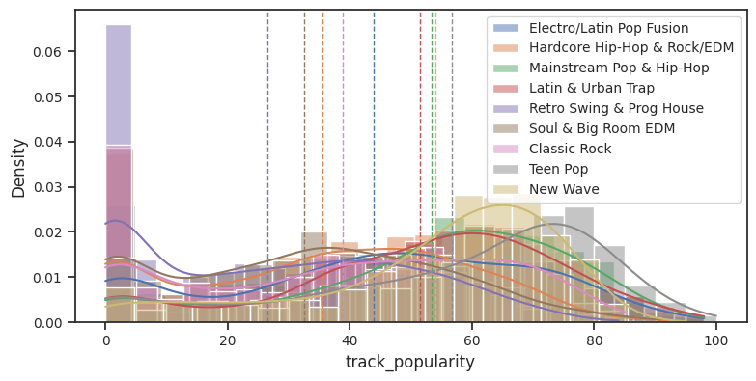
X: small_cat_cols
Musical key, 11 values
C♯/D♭ → 42.3 (=mean popularity)
Genre, 24 values grouped into 9
Teen Pop → 56.6 (=mean popularity)
Mode, 2 values
Major → 40.1 (=mean popularity)
Notes:
Key: replaced with symbols for a better visualization
Genre: using ANOVA tests to reduce 24 categories to 9
Mode: ANOVA tests are suggesting modes are “similar”, from popularity PoV. Considering drop later in the process.
Replace small_cat_col with small_cat_mean_popularity, e.g. key_mean_popularity
Avoiding data leakage from “future” records, mean_popularity computed only from records up to “current” year (=2019). Applied to all records
All three small_cat_mean_popularity cols are of a normal distribution
There is a significant difference between the keys (p = 1.26e-04)
and between the genres (p = 0.0), but not between modes

Slide 13
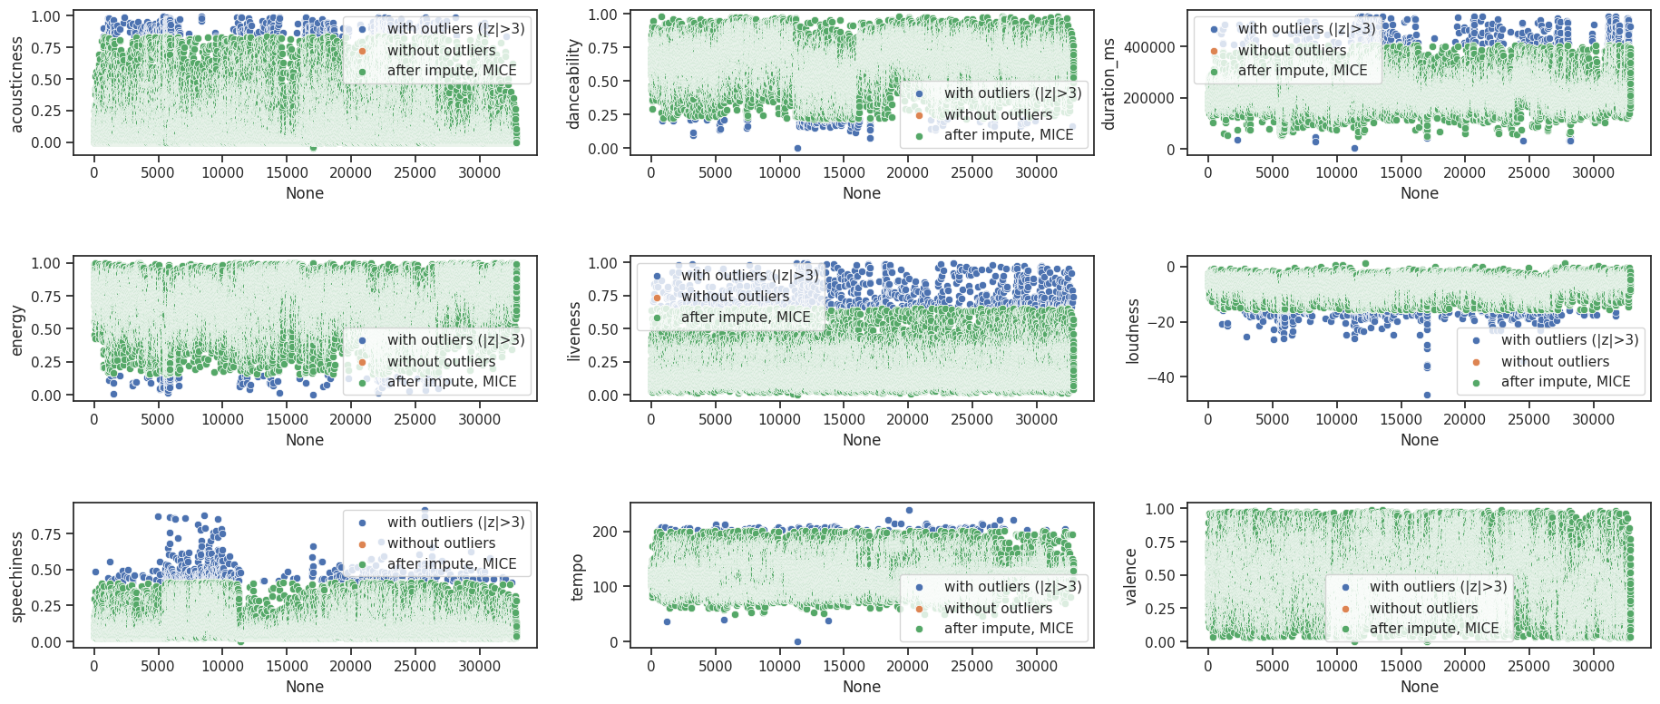
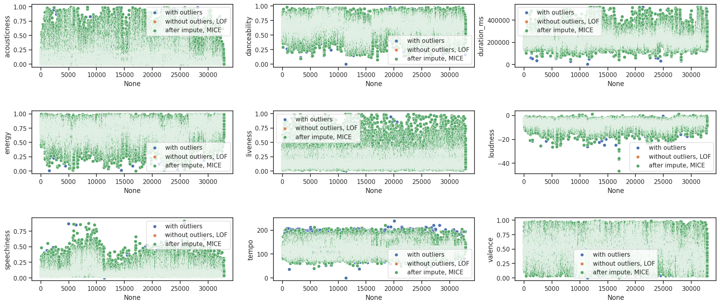
LOF vs z_score
LOF seems less intrusive
z_scores

Slide 14
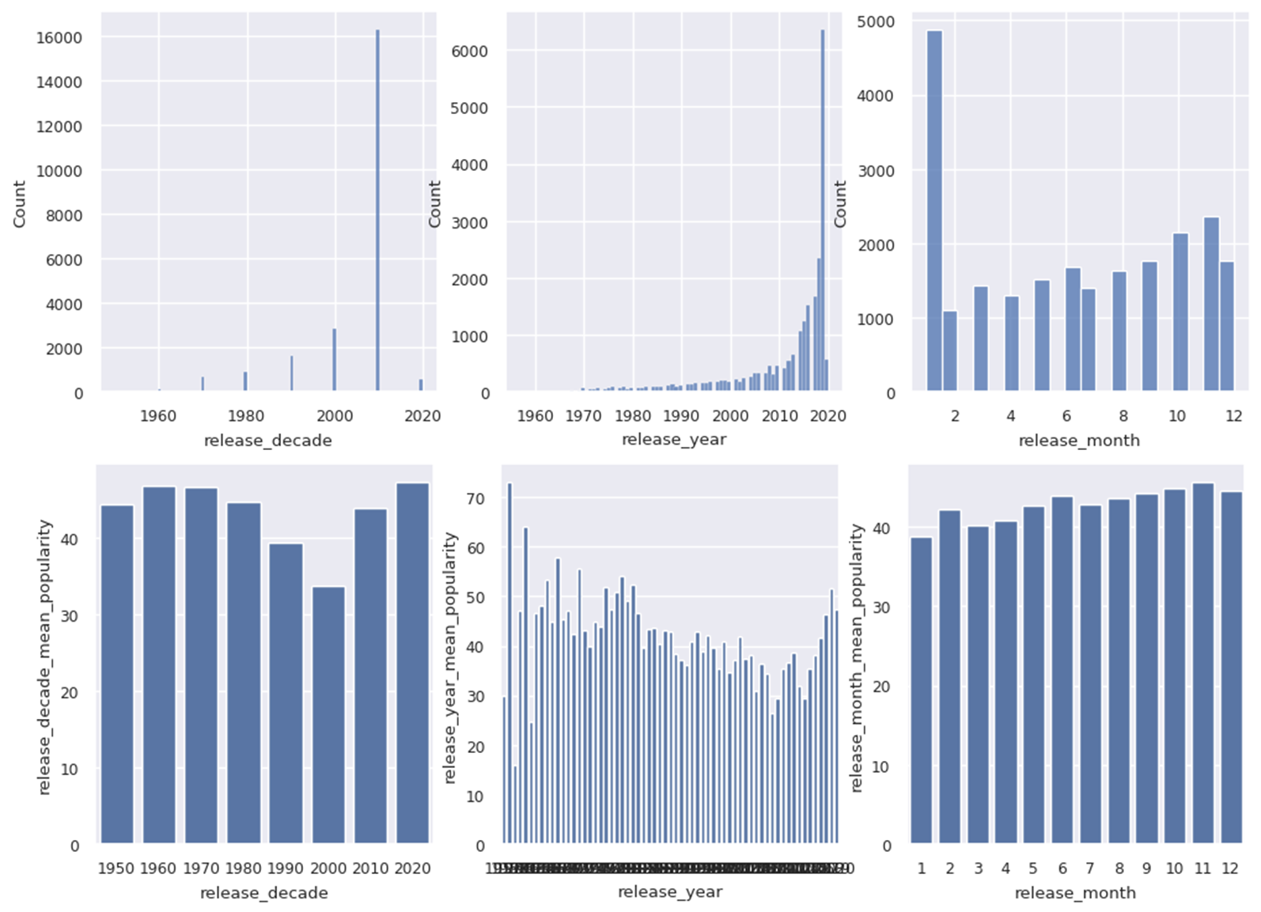
X cols: dates
album_release_date →
1. release_decade_mean_pop
2. release_year_mean_pop
3. release_decade_mean_pop
Notes:
One album release date col replaced with release_month and release_year

Slide 15
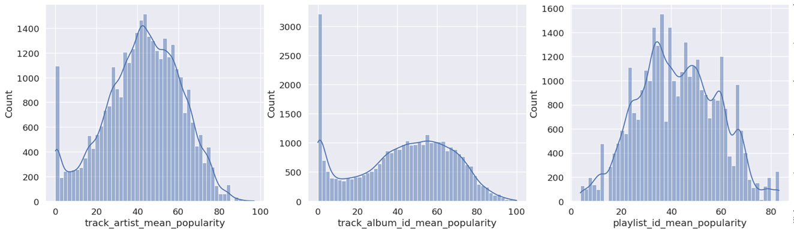
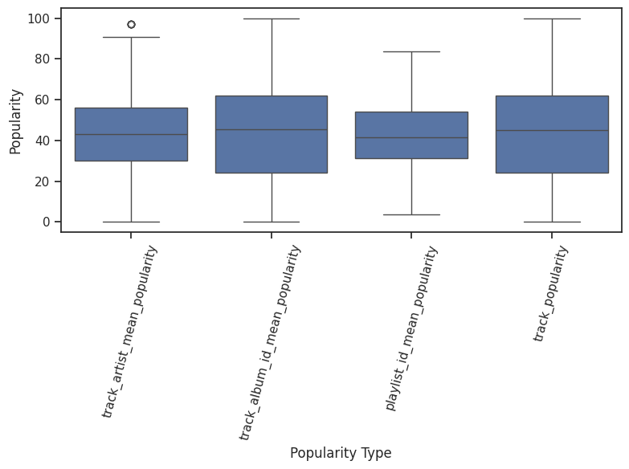
X: large_cat_cols
artist_id, album_id, playlist_id
“Bob Dylan” → 70.1
“Desire” (by Bob Dylan) → 76.9
“60s greatest hits” (incl. Dylan’s) → 64.7
skew: -0.3
skew: -0.26
skew: 0.08
Notes:
Avoiding data leakage from “future” records, mean_popularity computed only from records up to “current” year (=2019). Applied to all records
The three large_cat_mean_popularity cols and y_col are of a normal distribution
No significant difference between the means of the three (F-stat: 1.95, p-value: 0.12)

Slide 16
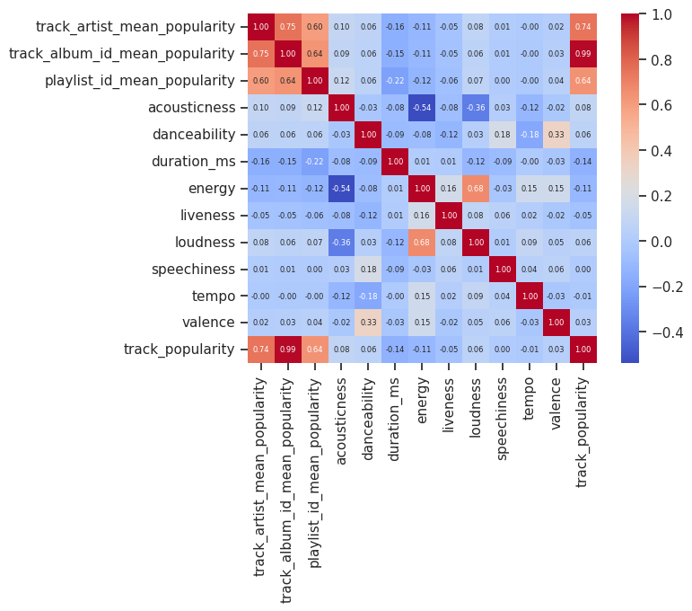
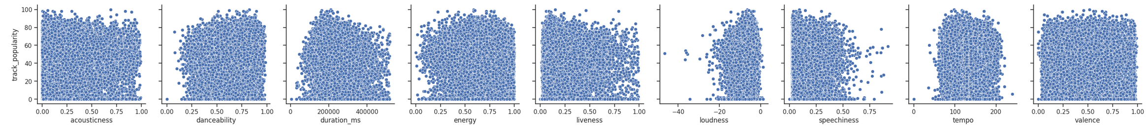
Distributions & Correlations
track_album_id_mean_popularity track_popularity 0.989
track_album_id_mean_popularity track_artist_mean_popularity 0.745
track_popularity track_artist_mean_popularity 0.742
loudness energy 0.675
loudness acousticness -0.36
acousticness energy -0.54

Slide 17
Pickle
 | count | mean | std | min | 25% | 50% | 75% | max
track_id (merge_on_col) | 32833.0 | 14215.5 | 8193.3 | 0.0 | 7115.0 | 14213.0 | 21342.0 | 28355.0
track_popularity (y_col) | 32833.0 | 42.5 | 25.0 | 0.0 | 24.0 | 45.0 | 62.0 | 100.0
danceability | 32833.0 | 0.7 | 0.1 | 0.2 | 0.6 | 0.7 | 0.8 | 1.0
energy | 32833.0 | 0.7 | 0.2 | 0.2 | 0.6 | 0.7 | 0.8 | 1.0
key | 32833.0 | 5.3 | 3.5 | 0.0 | 2.0 | 5.0 | 9.0 | 11.0
loudness | 32833.0 | -6.6 | 2.7 | -15.7 | -8.1 | -6.2 | -4.6 | 1.3
mode | 32833.0 | 0.4 | 0.5 | 0.0 | 0.0 | 0.0 | 1.0 | 1.0
speechiness | 32833.0 | 0.1 | 0.1 | 0.0 | 0.0 | 0.1 | 0.1 | 0.4
acousticness | 32833.0 | 0.2 | 0.2 | -0.0 | 0.0 | 0.1 | 0.3 | 0.8
liveness | 32833.0 | 0.2 | 0.1 | 0.0 | 0.1 | 0.1 | 0.2 | 0.7
valence | 32833.0 | 0.5 | 0.2 | 0.0 | 0.3 | 0.5 | 0.7 | 1.0
tempo | 32833.0 | 120.6 | 26.4 | 46.2 | 100.0 | 122.0 | 133.0 | 201.3
duration_ms | 32833.0 | 222636.5 | 52512.7 | 50705.0 | 187873.0 | 215933.0 | 251427.0 | 405291.0
playlist_genre_grouped | 32833.0 | 3.1 | 2.3 | 0.0 | 1.0 | 3.0 | 4.0 | 8.0
track_artist_mean_popularity | 32833.0 | 42.5 | 18.6 | 0.0 | 30.3 | 43.2 | 56.0 | 97.0
track_album_id_mean_popularity | 32833.0 | 42.5 | 24.7 | 0.0 | 24.0 | 45.7 | 62.0 | 100.0
playlist_id_mean_popularity | 32833.0 | 42.5 | 16.0 | 3.6 | 31.5 | 41.9 | 54.0 | 83.2
mode_mean_popularity | 32833.0 | 42.5 | 0.3 | 42.2 | 42.2 | 42.7 | 42.7 | 42.7
key_mean_popularity | 32833.0 | 42.5 | 0.9 | 40.9 | 42.0 | 42.5 | 43.0 | 44.6
playlist_genre_grouped_mean_popularity | 32833.0 | 42.5 | 8.6 | 27.3 | 35.8 | 43.5 | 50.6 | 56.8
release_year | 32833.0 | 2011.1 | 11.4 | 1957.0 | 2008.0 | 2016.0 | 2019.0 | 2020.0
release_month | 32833.0 | 6.1 | 3.8 | 1.0 | 2.0 | 6.0 | 10.0 | 12.0

Slide 18
SW engineering & process of work
A separate notebook for each stage (prep, edf, cleansing), using pickles between
Lots of software-engineering and automation. Resulting in a better understanding of the ML process, visualization of data, and math-based decision making
e.g. reducing categories based on ANOVA tests, or selection an optimal outlier algorithm based on ANOVA result of the impute algoritm
Each ‘redundant’ col (e.g artist_name) dropped to a pickle
A unique track_id col kept with the main df and with each pickle, as a pivot for possible merges later in the feature engineering stage

Slide 19
About the dataset
track_id
track_name
track_artist
track_popularity
track_album_id
track_album_name
track_album_release_date
playlist_name
playlist_id
playlist_genre
playlist_subgenre
23 cols x 32833 rows
danceability A value of 0.0 is least danceable and 1.0 is most danceable.
energy A measure from 0.0 to 1.0 and represents a perceptual measure of intensity and activity
key Standard Pitch Class notation . E.g. 0 = C, 1 = C♯/D♭, 2 = D, and so on.
loudness The overall loudness of a track in decibels (dB), typical range between -60 and 0 db
mode Major or Minor
speechiness Detects the presence of spoken words in a track, 0.0 to 1.0
acousticness A confidence measure from 0.0 to 1.0 of whether the track is acoustic
instrumentalness Predicts whether a track contains no vocals
liveness Detects the presence of an audience in the recording, 0.0 to 1.0
valence Describing the musical positiveness conveyed by a track 0.0 to 1.0
tempo The overall estimated tempo of a track in beats per minute (BPM)
duration_ms Duration of song in milliseconds

Slide 20
The business case
Hosting over 100M tracks, royalites are 60% (~$7B/year) of Spotify’s costs
From onetime $10/track, to annual $20/track, to $5,000/1million streams.
Spotiy’s spend on Toni&I royalties is estimated as $10M-$20M
Predicting popularity of new tracks can directly improve bottom-line results of business.
Especially for less known artists
Notes:
Other business advantages including IT costs, Recommendations, Automation of playlists, Marketing and Promotions of tracks
The target of my work is to predict popularity of new tracks. ‘Current time’ is end of 2019, my work is to predict popularity of 2020 releases

Slide 21
X cols: duplications
Three duplicated cols, dropped to a pickle for possible future use

Slide 22
Types of cols
y_col (1)
X_cols (21)
large_cat_cols (3)
small_cal_cols (3)
cont_cols (9)
date_cols (1)
Duplication and IDs (5)

